Slide 1
E-Commerce Business Analytics (Project)
Name: Gaurav Singh
Role: Data Analyst (Personal Project)
Description: This project focuses on analyzing e-commerce data to uncover meaningful insights related to sales performance, customer behavior, product trends, and overall business operations.
Using SQL for data extraction and Python libraries such as Matplotlib, Seaborn, and Plotly for visualization, the analysis aims to transform raw transactional data into actionable business insights.
The project covers key areas including sales analysis, customer segmentation, product performance, payment trends, seller evaluation, and customer reviews.
The goal of this project is to support data-driven decision-making by identifying growth opportunities, improving customer experience, and optimizing overall business performance.

Slide 2
Business Problem
The e-commerce business is generating a large volume of transactional data, but lacks a structured approach to analyze and utilize this data for strategic decision-making.
The key challenges include:
Understanding overall sales performance and revenue trends
Identifying top-performing products, categories, and sellers
Analyzing customer behavior, retention, and lifetime value
Evaluating payment preferences and transaction patterns
Detecting low-performing sellers and products impacting customer satisfaction.
Without proper analysis, the business may miss opportunities to increase revenue, improve customer experience, and optimize operations

Slide 3
Objective
The objective of this analysis is to transform raw e-commerce data into actionable insights that support business growth and decision-making.
The analysis aims to:
Measure key business metrics such as revenue, orders, and average order value (AOV)
Identify top-performing products, categories, and sellers
Understand customer behavior, retention, and lifetime value (CLV)
Analyze sales trends over time (monthly and yearly)
Evaluate payment methods and transaction patterns
Identify areas of improvement in seller performance and customer satisfaction.
The ultimate goal is to provide data-driven recommendations to increase revenue, improve efficiency, and enhance the overall customer experience.

Slide 4


1. Business Metrics Overview
Total Orders: The platform has processed 1,000,000 orders, indicating strong transaction volume and active customer engagement.
Total Revenue: Total revenue generated is ₹405,344,052, reflecting healthy business growth and market traction.

Slide 5


Average Order Value (AOV): Average order value stands at ₹405.34, suggesting moderate spending per customer and potential for upselling strategies.
Total Customers: There are 200,000 registered customers, highlighting a sizable and growing customer base.

Slide 6



Total Sellers: The marketplace includes 10,000 sellers, demonstrating a diverse seller ecosystem.
Total Products: 50,000 products are listed, providing a wide variety for customer choice and inventory opportunities.
Total Quantity Sold: 2,999,255 items have been sold, showing strong product turnover and sales activity.

Slide 7
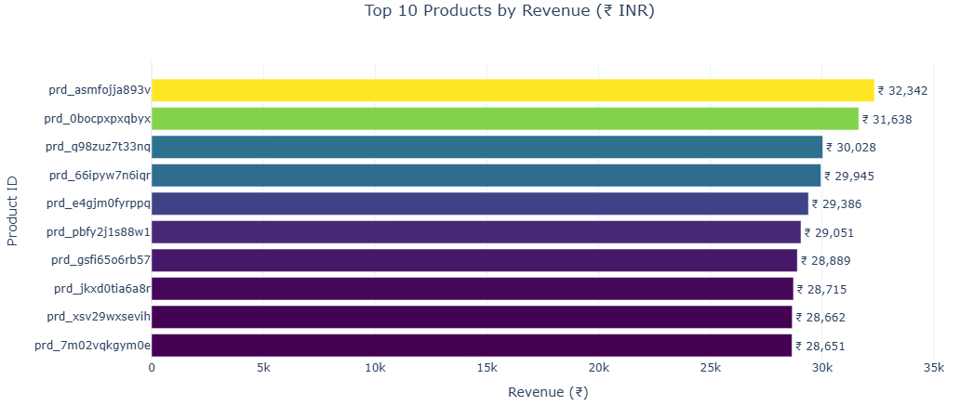
2. Sales Analysis
Top 10 Products by Revenue:
The top 10 products generate a significant portion of total revenue, with the highest-grossing product (prd_asmfojja893v) earning ₹32,342.
Revenue among the top 10 products ranges from ₹28,651 to ₹32,342 indicating multiple strong contributors.
Actionable Insights:
Focus marketing, inventory, and promotions on these high-revenue products.

Slide 8
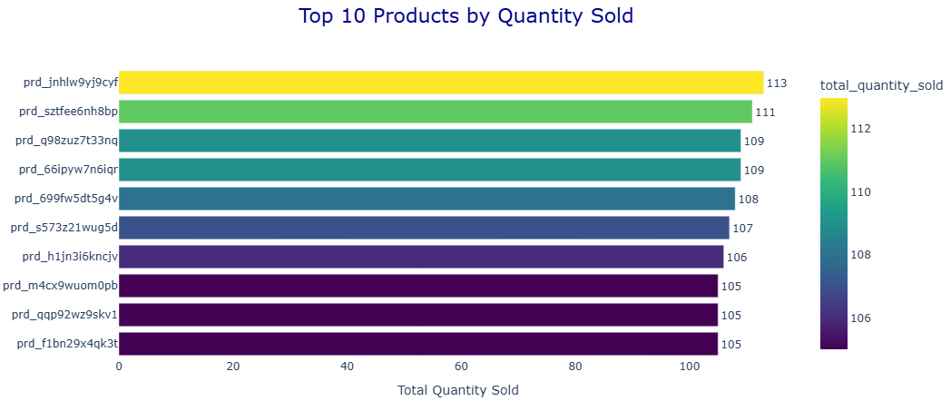
Top 10 Products by Quantity Sold:
The product with the highest quantity sold (prd_inhlw9yj9cyf) sold 113 units, while most top products sold between 105–113 units.
Products appearing in both revenue and quantity lists ("prd_q98zuz7t33nq", "prd_66ipyw7n6iqr") show a balance of high value + high demand.
Actionable Insights:
Monitor inventory for these high-demand items to avoid stockouts.

Slide 9
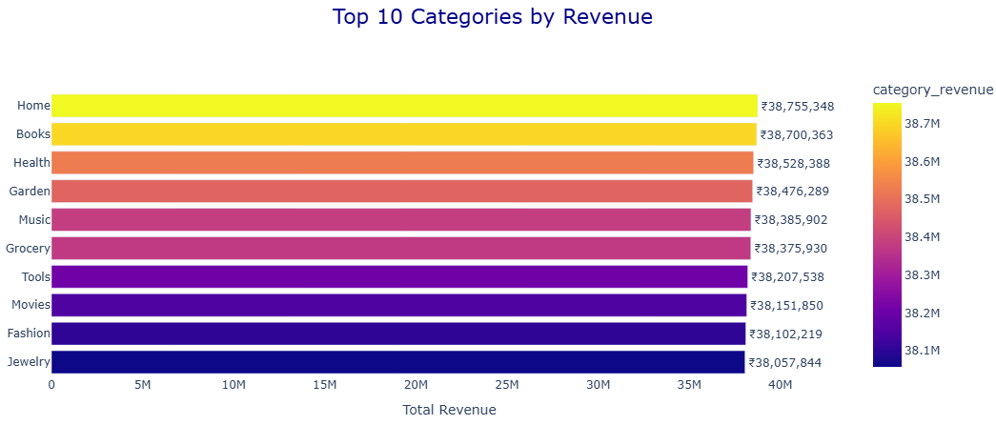
Top 10 Categories by Revenue:
The top 10 categories contributing the most revenue are: "Home","Books","Health","Garden","Music","Grocery","Tools", "Movies","Fashion","Jewelry".
These categories are key revenue drivers for the business.
Actionable Insights:
Focus marketing, promotions, and bundled offers on these top-performing categories to further increase sales and customer engagement.

Slide 10
Monthly Revenue Trend:
The monthly revenue from 2019 to 2024 shows a stable and consistent trend, indicating a well-performing and mature business.
Revenue remains within a narrow range of approximately ₹5.1M to ₹5.8M per month, reflecting low volatility and predictable performance.
Peak revenue is generally observed in July and December, indicating strong seasonal demand during mid-year and year-end periods.
February consistently records lower revenue across multiple years, making it a recurring low-performance month.
Minor fluctuations are observed in other months, but overall revenue remains fairly stable throughout the year.
Actionable Insights:
Boost Sales in Low Months (February):
Introduce discounts, offers, and marketing campaigns to increase demand.
Maximize Peak Months (July, December):
Increase inventory, promotions, and ad spend to capitalize on high demand.
Improve Revenue Consistency:
Use bundle offers and cross-selling strategies to reduce minor fluctuations.

Slide 11
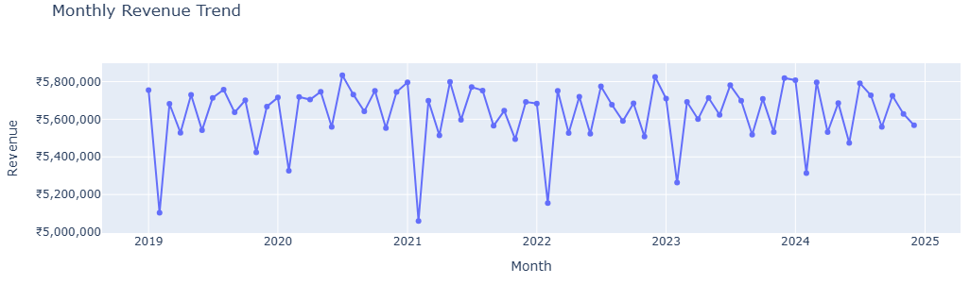
Yearly Revenue Growth :
The yearly revenue from 2019 to 2024 shows relatively stable performance, ranging between ₹67.2M to ₹68.0M per year.
Highest revenue was recorded in 2020 (₹68.03M), while 2021 (₹67.38M) and 2022 (₹67.42M) show slight dips, indicating minor fluctuations year-over-year.
Overall, the revenue trend indicates consistent business growth with no significant decline, reflecting a mature and stable marketplace.

Slide 12
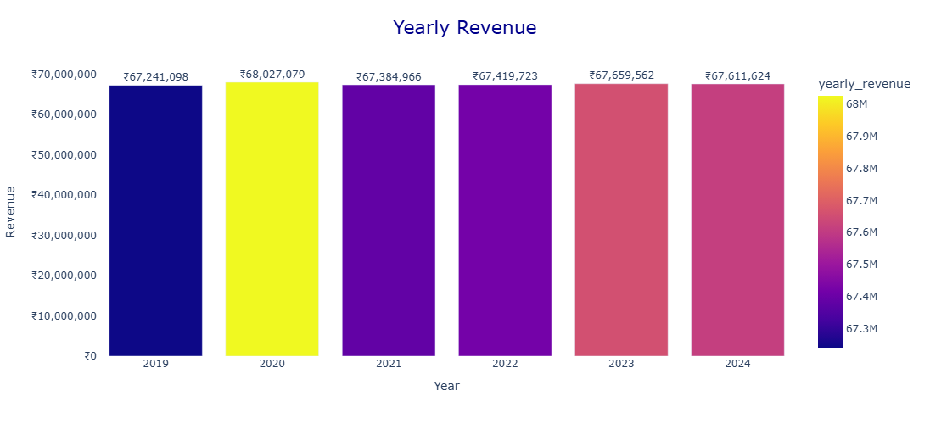
Actionable Insights:
Maintain strategies that supported consistent revenue in past years.
Investigate the slight dips (2021–2022) to see if external factors or seasonal variations affected sales.
Explore new promotions, product launches, or seasonal campaigns to increase growth in flat revenue years.

Slide 13
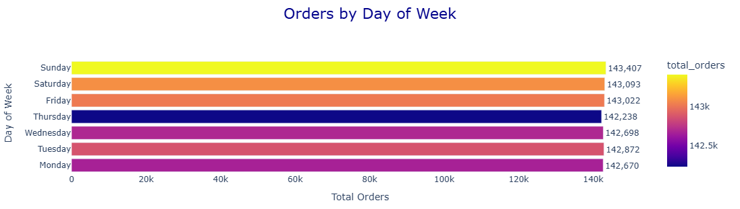
Day of Week with Highest Orders :
Order data shows that Sunday has the highest number of orders (143,407), closely followed by Saturday (143,093) and Friday (143,022).
The weekend sees slightly higher order volumes, while weekdays have relatively lower but stable orders, with Thursday being the lowest (142,238).
Actionable Insights:
Optimize marketing campaigns around weekends to maximize conversion, as customer activity peaks then.
Ensure inventory and delivery logistics are fully prepared for high-volume days (Fri–Sun).
Consider running special offers or flash sales on weekdays to boost engagement during lower-order days.

Slide 14
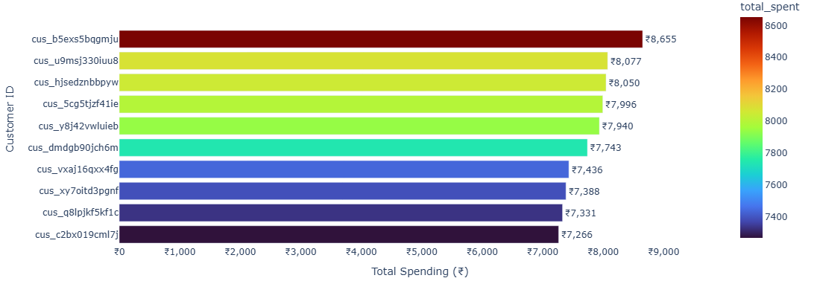
3. Customer Analysis
Top 10 Customers by Spending:
The top 10 customers have spent between ₹7,266 and ₹8,655, with cus_b5exs5bqgmju being the highest spender at ₹8,655.
This indicates a small group of high-value customers contributing significantly to overall revenue.
Actionable Insights:
Focus on loyalty programs and personalized offers for these top customers to retain them.
Analyze their purchasing patterns to cross-sell or upsell related products.
Use insights from top customer behavior to target similar customer segments.

Slide 15

Average Orders per Customer:
On average, each customer places about 5 orders, indicating moderate repeat purchase behavior across the customer base.
Actionable Insights:
Encourage customers to increase purchase frequency through loyalty programs, subscription options, or targeted promotions.
Segment customers based on purchase frequency to create personalized campaigns.
Focus on converting one-time buyers into repeat buyers to boost overall revenue.

Slide 16

Number of Repeat Customers:
The dataset shows 191,872 repeat customers, indicating that a large portion of customers return to make additional purchases.
This reflects strong customer retention and satisfaction, which is essential for sustainable e-commerce growth.
Actionable Insights:
Maintain customer satisfaction through quality service, fast delivery, and reliable products.
Implement loyalty programs, reward points, or exclusive discounts to further strengthen repeat purchasing behavior.
Analyze repeat customer purchase patterns to identify high-demand products and personalized marketing opportunities.

Slide 17
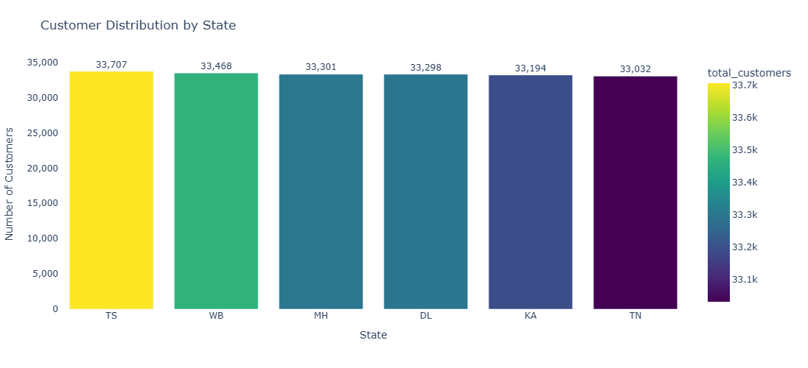
Customer Distribution by State:
Customer data shows that the highest number of customers come from TS (33,707), followed closely by WB (33,468) and MH (33,301).
Other major contributing states include DL (33,298), KA (33,194), and TN (33,032).
The relatively similar customer counts across these states indicate a well-distributed customer base across multiple regions rather than dependence on a single state.
Actionable Insights:
Focus regional marketing campaigns in these high-customer states to further increase sales.
Strengthen logistics and delivery infrastructure in these regions to improve customer experience.
Use targeted promotions or localized advertising to increase engagement in these key markets.

Slide 18
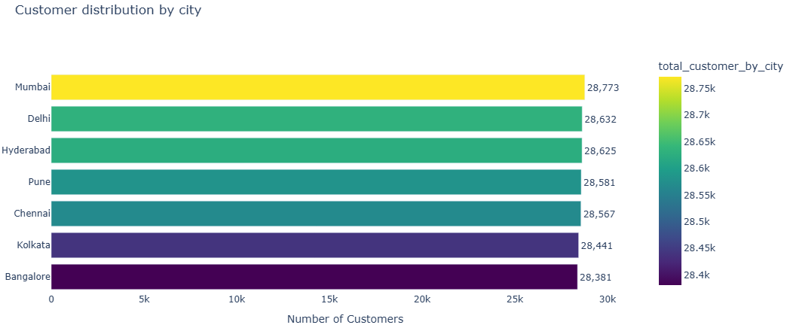
Customer Distribution by City :
The highest number of customers come from Mumbai (28,773), followed closely by Delhi (28,632) and Hyderabad (28,625).
Other major customer cities include Pune (28,581), Chennai (28,567), Kolkata (28,441), and Bangalore (28,381).
The customer base is spread across multiple major metropolitan cities, indicating that urban markets play a significant role in driving e-commerce demand.
Actionable Insights:
Focus targeted marketing campaigns in these high-customer metropolitan cities to increase conversions.
Strengthen last-mile delivery and logistics in these urban areas to maintain customer satisfaction.
Introduce city-specific promotions or fast delivery options to attract more customers in these key markets.

Slide 19
4.Payment Analysis
Most Used Payment Method :
The most frequently used payment method is Credit Card, with 250,426 transactions, making it the most preferred payment option among customers.
Other payment methods such as Debit Card (250,167), Net Banking (249,749), and UPI (249,658) also show very similar usage levels.
The relatively close transaction counts across all payment methods indicate that customers are comfortable using multiple digital payment options, resulting in a balanced payment distribution.
Actionable Insights:
Businesses should ensure secure and seamless payment processing across all major payment methods.
Offering cashback, EMI options, or discounts on credit/debit card payments may help increase order value.
Maintaining support for multiple payment options ensures greater flexibility and improved checkout experience for customers.

Slide 20
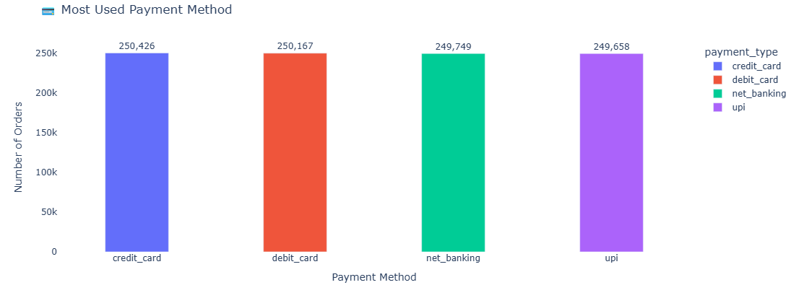
Revenue by Payment Type :
Revenue generated through different payment methods is almost evenly distributed.
Debit Card contributes the highest revenue with ₹101,447,226, followed closely by Credit Card (₹101,399,822), UPI (₹101,267,718), and Net Banking (₹101,229,285).
The minimal difference in revenue contribution across payment methods indicates that customers use multiple digital payment options without strong dependence on a single method.

Slide 21
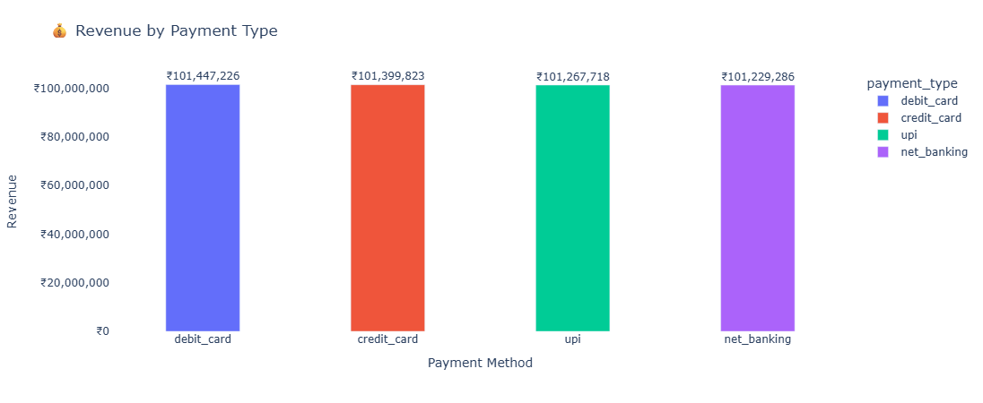
Actionable Insights:
Businesses should continue supporting multiple digital payment methods to ensure a flexible checkout experience.
Partnerships with payment providers for cashback, discounts, or promotional offers can help boost sales.
Monitoring payment trends can help identify emerging payment preferences and optimize payment strategy.

Slide 22

Average Payment Value :
The average payment value across all transactions is ₹405.34, indicating the typical amount customers spend per payment.
This suggests that the platform experiences moderate transaction values, reflecting consistent purchasing behavior across customers.
A stable average payment value indicates a balanced mix of low-cost and mid-range product purchases on the platform.
Actionable Insights:
Businesses can increase the average payment value by introducing product bundles, combo offers, or bulk purchase discounts.
Implementing free shipping thresholds above a certain order value may encourage customers to add more items to their cart.
Targeted promotions for higher-value products could help boost overall transaction value.

Slide 23
5. Product Analysis
Top 10 product categories with the highest quantity sold:
The Home category recorded the highest number of products sold with 153,691 units, making it the most popular product category among customers.
Other high-performing categories include Books (153,012), Garden (152,372), Music (152,224), and Health (152,061).
Categories such as Grocery, Fashion, Tools, Movies, and Baby also show strong sales volume, indicating diverse customer demand across multiple product segments.
The relatively small difference in quantity sold across the top categories suggests that customer purchases are well distributed across various product categories rather than being dominated by a single category.
Actionable Insights:
Businesses should ensure consistent inventory availability for these high-demand categories to avoid stock shortages.
Marketing campaigns and product promotions can focus on these popular categories to maximize sales opportunities.
Cross-selling related products within these categories can help increase average order value.

Slide 24
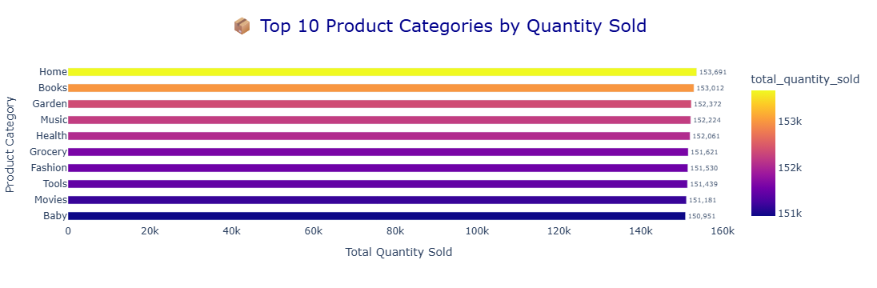
Top 10 Most Expensive Product Categories :
The Fashion category records the highest product value with ₹645,849.97, making it the most expensive product category on the platform.
Other premium categories include Health (₹643,329.55), Tools (₹642,073.51), Garden (₹641,744.85), and Books (₹640,875.54).
Categories such as Home, Baby, Movies, Jewelry, and Shoes also appear among the top high-value categories, indicating that multiple segments offer premium-priced products.
The close price range across these categories suggests that high-value products are distributed across several categories rather than concentrated in a single category.

Slide 25
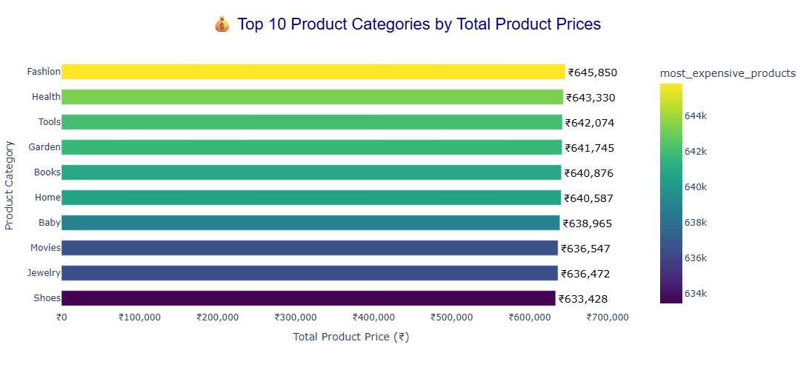
Actionable Insights:
Businesses can promote these categories as premium or high-value segments to increase revenue.
Offering EMI options, discounts, or bundled deals can encourage customers to purchase high-priced products.
Highlighting premium products in featured sections or recommendation systems may further boost sales.

Slide 26
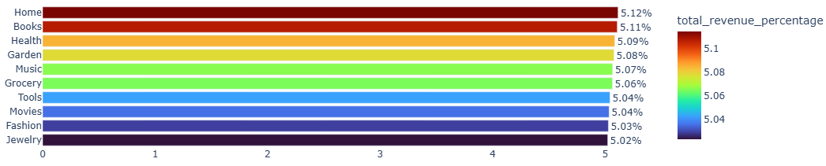
Top 10 Product Categories Contributing the Highest Percentage of Revenue:
The Home category contributes the highest share of total revenue at approximately 5.12%, making it one of the key revenue drivers for the platform.
Other major contributing categories include Books (5.11%), Health (5.09%), Garden (5.08%), and Music (5.07%).
Additional categories such as Grocery (5.06%), Tools (5.04%), Movies (5.04%), Fashion (5.03%), and Jewelry (5.02%) also contribute a similar share of revenue.
The small difference in revenue percentages across these categories indicates that revenue generation is well distributed across multiple product segments rather than being dominated by a single category.
Actionable Insights:
Businesses should continue promoting these top-performing categories to maintain strong revenue generation.
Cross-selling and recommendation strategies within these categories can help increase overall order value.
Maintaining inventory and competitive pricing in these categories will help sustain consistent revenue growth.

Slide 27
Products Never Ordered :
The analysis shows that there are no products in the catalog that were never ordered, meaning every listed product has been purchased at least once.
This indicates good product visibility and balanced customer demand across the product catalog.
The absence of unsold products suggests that the platform maintains an efficient product selection strategy, where most items attract some level of customer interest.
Actionable Insights:
Continue maintaining a diverse product catalog that appeals to different customer segments.
Analyze low-selling products (if any) to identify opportunities for pricing adjustments or promotional campaigns.
Maintain effective product recommendations and search visibility to ensure all products remain discoverable.

Slide 28
6.Seller Analysis
Top 10 Seller with Highest Revenue :
The seller sel_edc0u69wt77f generated the highest revenue of approximately ₹109,379, making them the top-performing seller on the platform.
Other high-performing sellers include sel_bjddfg4wbwep (₹103,551), sel_zend4v1r77w4 (₹103,288), and sel_womnv2nuov3o (₹102,913).
The revenue difference among the top 10 sellers is relatively small, indicating that multiple sellers contribute significantly to overall marketplace revenue rather than a single seller dominating the platform.
Actionable Insights:
Strengthen partnerships with these top-performing sellers to maintain high sales performance.
Provide incentives such as featured listings or promotional opportunities for high-revenue sellers.
Analyze the strategies used by top sellers to help other sellers improve their performance.

Slide 29
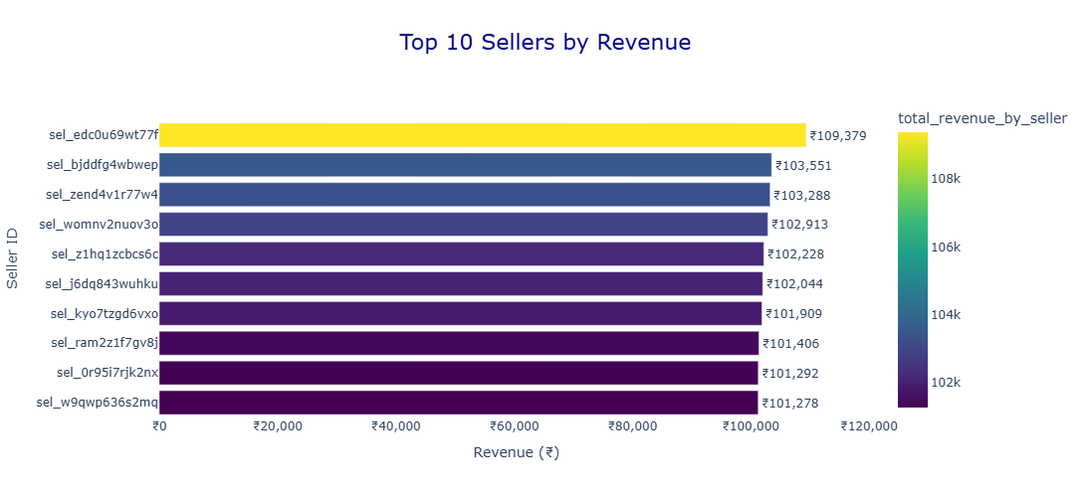

Slide 30
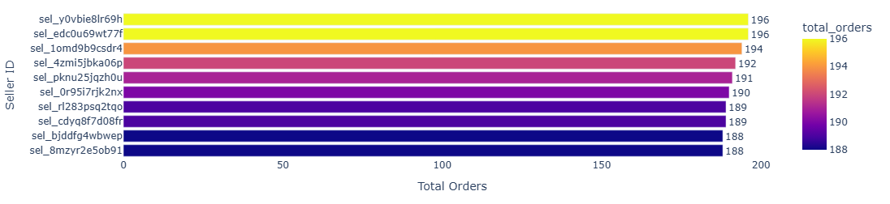
Top 10 Seller with Most Orders :
The sellers sel_edc0u69wt77f and sel_y0vbie8lr69h recorded the highest number of orders, with 196 orders each, making them the most active sellers on the platform.
Other high-volume sellers include sel_1omd9b9csdr4 (194 orders), sel_4zmi5jbka06p (192 orders), and sel_pknu25jqzh0u (191 orders).
Sellers such as sel_0r95i7rjk2nx, sel_cdyq8f7d08fr, sel_rl283psq2tqo, sel_8mzyr2e5ob91, and sel_bjddfg4wbwep also contribute significantly to the total order volume.
The small difference in order counts among the top sellers indicates that sales activity is relatively balanced across multiple sellers rather than dominated by a single seller.
Actionable Insights:
Provide incentives or recognition programs for high-volume sellers to maintain their performance.
Analyze the strategies used by these sellers to identify best practices that can be shared with other sellers.
Ensuring efficient inventory and order fulfillment for these sellers will help maintain consistent customer satisfaction.

Slide 31
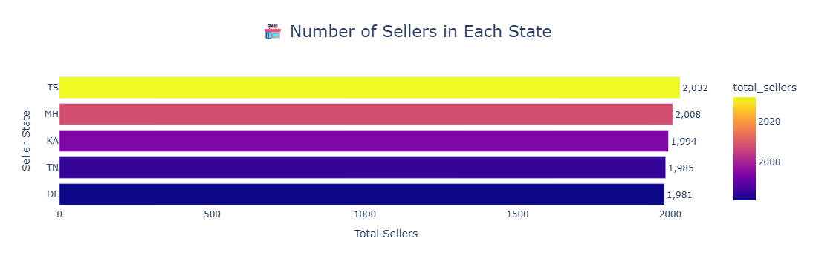
Seller Distribution by State :
The highest number of sellers are located in TS (2,032 sellers), followed by MH (2,008) and KA (1,994).
Other major seller locations include TN (1,985) and DL (1,981).
The seller base is spread across multiple major states, indicating a well-distributed marketplace supply network rather than dependence on a single region.
Actionable Insights:
Strengthening logistics and delivery infrastructure in these states can help improve order fulfillment efficiency.
Encouraging more sellers from other regions could help expand marketplace diversity and product availability.
Regional seller support programs and training can help improve seller performance and overall sales growth.

Slide 32

7.Review Analysis
Average Review Score :
The overall average review score is 3.00, indicating a moderate level of customer satisfaction across the platform.
A score around the midpoint suggests that while many customers are satisfied, there is still room for improvement in product quality, delivery experience, or customer service.
Maintaining or improving customer satisfaction is essential for long-term customer retention and positive brand reputation.
Actionable Insights:
Analyze customer feedback to identify common issues affecting product ratings.
Improve product quality, delivery efficiency, and customer support to increase customer satisfaction.
Encourage satisfied customers to leave reviews, which can help improve the overall rating and credibility of the platform.

Slide 33
Cusotmer Review Score Distribution:
The distribution of review scores is almost evenly spread across all rating levels from 1 to 5.
Ratings 2 (60,156) and 1 (60,066) are slightly higher compared to other ratings, while 4 (59,808) and 5 (59,911) are slightly lower.
The relatively balanced distribution indicates that customer experiences vary significantly, with both positive and negative feedback present across the platform.
This pattern suggests that while some customers are satisfied, others may face issues related to product quality, delivery time, or service experience.
Actionable Insights:
Analyze low-rated reviews (1–2 stars) to identify common customer complaints.
Improve product quality control and seller performance monitoring to reduce negative experiences.
Encourage satisfied customers to leave 4–5 star reviews to improve the overall rating distribution.

Slide 34
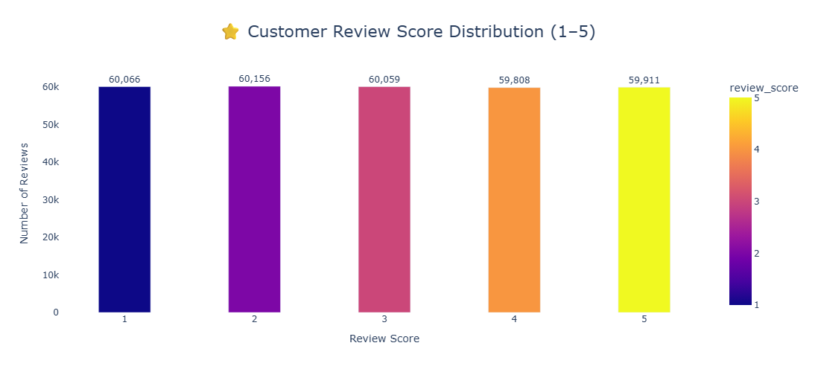
Top 10 Product Categories By Average Rating :
The Grocery category has the highest average rating at 3.01, making it the top-rated product category on the platform.
Other highly rated categories include Books (3.01), Electronics (3.00), Home (3.00), and Baby (3.00).
Categories such as Computers, Shoes, Automotive, Pet, and Fashion also maintain ratings close to 3.00, indicating relatively consistent customer feedback across categories.
The small variation in ratings suggests that customer satisfaction levels are fairly similar across most product categories.

Slide 35
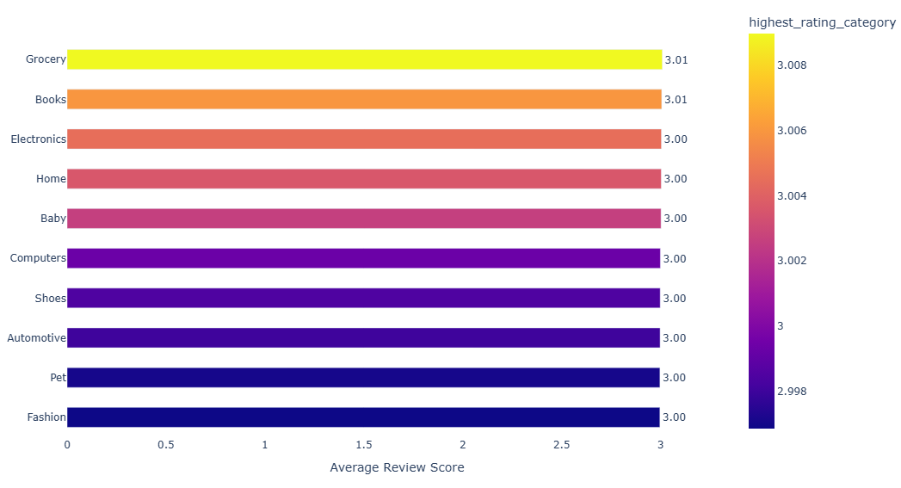
Actionable Insights:
Identify the factors contributing to higher ratings in categories like Grocery and Books and replicate those strategies across other categories.
Monitor customer feedback to improve product quality and seller performance in lower-rated categories.
Promote highly rated categories in marketing campaigns and recommendations to build customer trust.

Slide 36
Top 10 Sellers with Lowest Rating :
The seller sel_ffplat10d2nf has the lowest average rating at 2.17, making them the lowest-performing seller in terms of customer satisfaction.
Other low-rated sellers include sel_zjqbwxts9czw (2.19), sel_0rxog3hg57vu (2.24), and sel_ot3pnemeg8dr (2.24).
All bottom-performing sellers have ratings in the range of 2.17 to 2.31, which is significantly below the platform average of 3.00.
This indicates that these sellers may be facing issues related to product quality, delivery delays, or poor customer service.
Actionable Insights:
Identify and address issues faced by these sellers through performance monitoring and feedback analysis.
Provide training or guidelines to improve product quality, packaging, and delivery standards.
Implement stricter quality checks or penalties for consistently low-rated sellers to maintain platform standards.

Slide 37
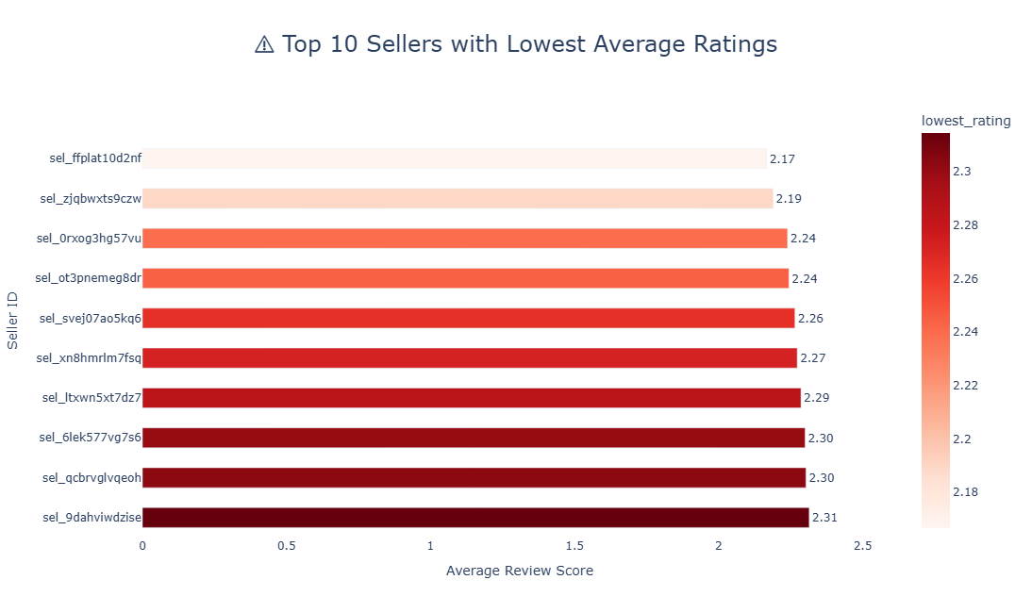

Slide 38
8.Advanced Business Question
Top 5 Months with Highest Revenue :
July generated the highest revenue of approximately ₹34.67M, making it the peak sales month.
Other high-performing months include January (₹34.47M), May (₹34.40M), August (₹34.35M), and March (₹34.34M).
The revenue difference among the top 5 months is relatively small, indicating stable demand with slight seasonal peaks.
Mid-year months like May, July, and August show strong performance, suggesting possible influence of seasonal demand or promotional activities.
Actionable Insights:
Focus marketing campaigns and discounts during July and nearby months to maximize revenue.
Analyze what drives sales in top-performing months (festivals, offers, demand trends) and replicate those strategies.
Plan inventory and logistics in advance for these peak months to avoid stockouts and delays.

Slide 39
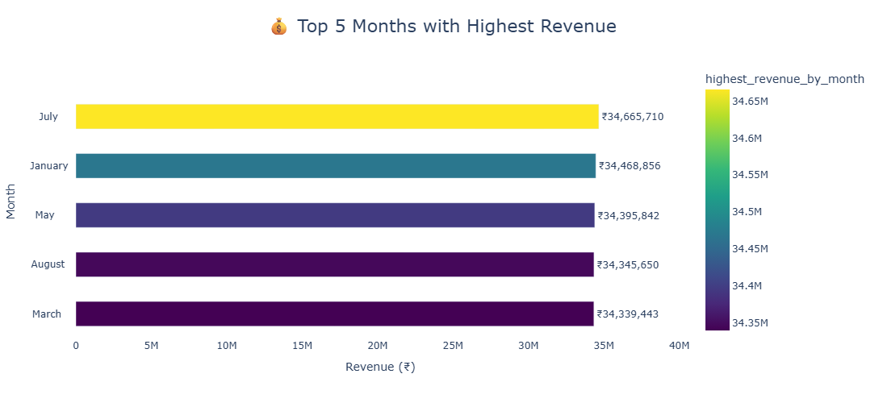

Slide 40
Top 10 Customers by Lifetime Value (CLV) :
The customer cus_b5exs5bqgmju has the highest lifetime value at ₹8655.41, making them the most valuable customer for the business.
Other high-value customers include cus_u9msj330iuu8 (₹8077.28), cus_hjsedznbbpyw (₹8050.40), and cus_5cg5tjzf41ie (₹7996.30).
The top 10 customers all have CLV in the range of approximately ₹7266 to ₹8655, indicating a group of premium, high-spending customers.
These customers contribute significantly more revenue compared to the average customer, highlighting the importance of customer retention and loyalty.
Actionable Insights:
Create loyalty programs, rewards, or exclusive offers for high-value customers to retain them.
Use personalized marketing (emails, recommendations) to increase repeat purchases from these customers.
Analyze their buying behavior to identify patterns and target similar high-value customer segments.

Slide 41
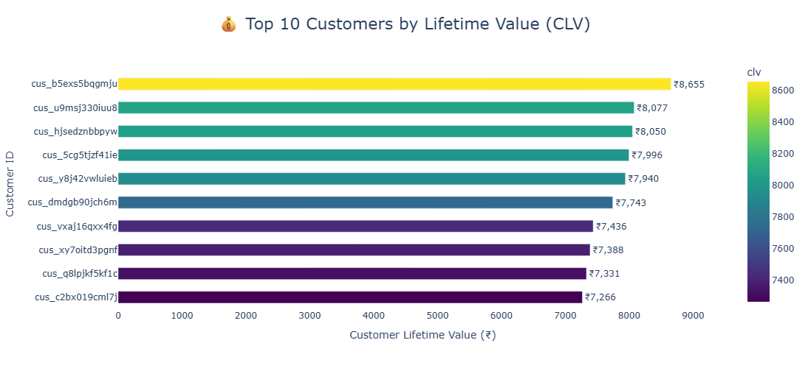

Slide 42
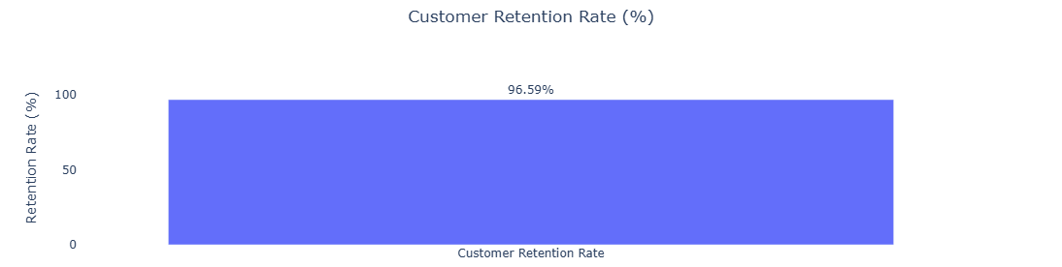
Calculate the percentage of customers who made repeat purchases during a period to measure customer loyalty:
The customer retention rate is 96.59%, indicating that a very high percentage of customers are making repeat purchases.
This shows strong customer loyalty and satisfaction, as most customers return to purchase again.
A retention rate above 90% is considered excellent, and this dataset reflects a highly engaged customer base.
It also suggests that the business has an effective customer experience, product quality, and service strategy.
Actionable Insights:
Maintain this high retention by continuing good service, timely delivery, and quality products.
Introduce loyalty programs and personalized offers to further strengthen repeat purchases.
Focus on increasing Customer Lifetime Value (CLV) since retained customers are more profitable.

Slide 43
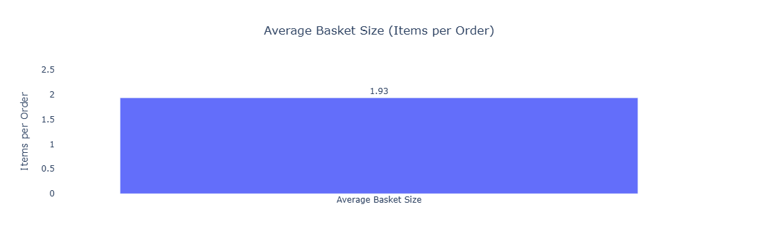
Average Basket Size (Items per Order) :
The average basket size is 1.93 items per order, indicating that customers typically purchase 1 to 2 items per transaction.
This suggests that most purchases are single-item focused, with limited multi-product buying behavior.
A basket size below 2 indicates an opportunity to increase cross-selling and upselling.
Actionable Insights:
Introduce bundle offers and combo deals to encourage customers to buy more items per order.
Use “Frequently Bought Together” recommendations to increase basket size.
Offer free shipping thresholds (e.g., buy 2+ items) to motivate customers to add more products.

Slide 44
Conclusion
The business shows strong and stable performance with consistent revenue trends over time.
A high customer retention rate (96.59%) indicates excellent customer loyalty and satisfaction.
A group of high-value customers (CLV) contributes significantly to overall revenue.
Revenue is well distributed across categories, reducing dependency on a single category.
However, the average basket size (1.93) is low, indicating limited multi-item purchases.
Some sellers have low ratings (~2.2–2.3), highlighting areas for improvement in service and product quality.

Slide 45
Recommendations
1. Increase Average Order Value (AOV):
Introduce bundle offers, combo deals, and upselling strategies.
2.Improve Low-Performing Sellers:
Monitor seller performance and provide training to improve ratings and service quality.
3.Leverage High-Value Customers:
Offer loyalty programs, exclusive deals, and personalized recommendations.
4.Capitalize on Peak Months:
Focus marketing campaigns during top-performing months like July and January.
5.Enhance Customer Experience:
Maintain fast delivery, product quality, and customer support to sustain high retention.

